Slide 1
SQL 2.1
Notes:
Highlights: Introduce yourself and the session.
Key Takeaways: NA

Slide 2
Learning Outcomes
At the end of this session, you will be able to:
Precise Data Retrieval: Use SELECT for targeted data extraction.
Refined Data Filtering: Apply WHERE for specific data segments.
Data Analysis Basics: Utilize COUNT() dataset insights.
Efficient Data Sampling: Employ LIMIT and OFFSET for dataset exploration.
Data Organization: Sort data using ORDER BY for logical arrangement.
Unique Data Identification: Understand distinct data with DISTINCT.
Data Summarization: Use GROUP BY with aggregate functions (SUM(), MAX(), MIN(), AVG()) for data condensation.
Filtered Analysis: Utilize HAVING for refined insights on aggregated data.
Clause Distinction: Differentiate between HAVING and WHERE for specific filtering purposes.
Notes:
Duration: 10 minutes
Highlights:
Introduce the definition.
Identify the unique attributes.
Provide examples to elaborate the concept and non-examples to show the difference.
Use whiteboard if required.
Key Takeaways:
In what ways, learners can use the concept in real-life situations to provide solutions or solve problems.

Slide 3

Database
A database is a collection of interrelated data. It’s a collection of information that is organized so that it can be easily accessed, managed and updated.
E.g.:
School Data
Companies Database
Notes:
Duration: 10 minutes
Highlights:
Introduce the definition.
Identify the unique attributes.
Provide examples to elaborate the concept and non-examples to show the difference.
Use whiteboard if required.
Key Takeaways:
In what ways, learners can use the concept in real-life situations to provide solutions or solve problems.

Slide 4

Advantages of Database
Avoids Repetition
Makes Sharing Easy
Protects Your Data
Maintains Quality
Notes:
Duration: 10 minutes
Highlights:
Introduce the definition.
Identify the unique attributes.
Provide examples to elaborate the concept and non-examples to show the difference.
Use whiteboard if required.
Key Takeaways:
In what ways, learners can use the concept in real-life situations to provide solutions or solve problems.

Slide 5




Database Management System (DBMS)
A Database Management System (DBMS) is like a special toolbox for organizing and using information. It's software that helps us set up and manage a database. It's made up of different tools (programs) that store, find, and work with data. And it makes sure our information stays safe while we use it.
Notes:
Duration: 10 minutes
Highlights:
Introduce the definition.
Identify the unique attributes.
Provide examples to elaborate the concept and non-examples to show the difference.
Use whiteboard if required.
Key Takeaways:
In what ways, learners can use the concept in real-life situations to provide solutions or solve problems.

Slide 6
Relational Database Model (RDMS)
In relational data models, data is organized in tables (rows and columns). These tables are called relations.
Name | Subject | Marks
Rahul | Python | 80
Sachin | Machine Learning | 70
Ojas | SQL | 96
Khushi | Maths | 78
Aditya | Python | 65
Notes:
Duration: 10 minutes
Highlights:
Introduce the definition.
Identify the unique attributes.
Provide examples to elaborate the concept and non-examples to show the difference.
Use whiteboard if required.
Key Takeaways:
In what ways, learners can use the concept in real-life situations to provide solutions or solve problems.

Slide 7

Terminologies (Reverse Words)
Relation: A table storing logically related data.
Domain: Pool of values from which the actual values appearing in a given column are drawn.
Tuple: Row
Attribute: Column
Degree: Number of rows/tuples.
Notes:
Duration: 10 minutes
Highlights:
Introduce the definition.
Identify the unique attributes.
Provide examples to elaborate the concept and non-examples to show the difference.
Use whiteboard if required.
Key Takeaways:
In what ways, learners can use the concept in real-life situations to provide solutions or solve problems.

Slide 8

Structured Query Language (SQL)
SQL, which stands for Structured Query Language, is like a special language used to talk to databases. Almost every system that manages databases understands this language. It's a set of commands that helps us create and work with databases that organize information in a specific way.
Resources Link: employees_dataset
Notes:
Duration: 10 minutes
Highlights:
Introduce the definition.
Identify the unique attributes.
Provide examples to elaborate the concept and non-examples to show the difference.
Use whiteboard if required.
Key Takeaways:
In what ways, learners can use the concept in real-life situations to provide solutions or solve problems.

Slide 9

SELECT Statement
The first thing that one can do when one wants to query data is to instruct the SQL engine as to which columns need to be included in the analysis. For that we use a SQL statement SELECT.
The general syntax of SELECT statement is: SELECT col_name1, col_name2, col_name3 FROM TABLE_NAME;
One can also select all the columns from a given table using the * wildcard. Given is the syntax for the select statement querying all the columns in a given table: SELECT * FROM TABLE_NAME;
Notes:
Duration: 10 minutes
Highlights:
Introduce the definition.
Identify the unique attributes.
Provide examples to elaborate the concept and non-examples to show the difference.
Use whiteboard if required.
Key Takeaways:
In what ways, learners can use the concept in real-life situations to provide solutions or solve problems.

Slide 10
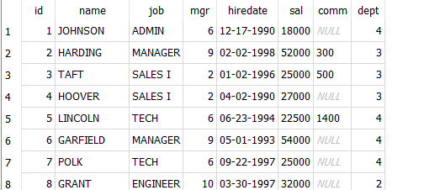
SELECT Statement
Syntax: SELECT * FROM employees;
Notes:
Duration: 10 minutes
Highlights:
Introduce the definition.
Identify the unique attributes.
Provide examples to elaborate the concept and non-examples to show the difference.
Use whiteboard if required.
Key Takeaways:
In what ways, learners can use the concept in real-life situations to provide solutions or solve problems.

Slide 11
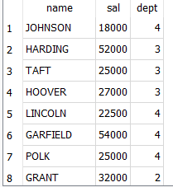
SELECT Statement
Selecting a column (columns)
Syntax: SELECT col1, col2 FROM employees;
SELECT name, sal, dept FROM employees;
Notes:
Duration: 10 minutes
Highlights:
Introduce the definition.
Identify the unique attributes.
Provide examples to elaborate the concept and non-examples to show the difference.
Use whiteboard if required.
Key Takeaways:
In what ways, learners can use the concept in real-life situations to provide solutions or solve problems.

Slide 12
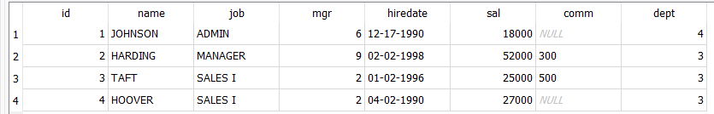
LIMIT Statement
The LIMIT statement in SQL restricts the number of rows returned in a query result, allowing you to specify a maximum number of rows to be fetched from a database table.
Syntax:
SELECT * FROM Table_Name LIMIT 5;
OR
SELECT * FROM employees LIMIT 4;
Notes:
Duration: 10 minutes
Highlights:
Introduce the definition.
Identify the unique attributes.
Provide examples to elaborate the concept and non-examples to show the difference.
Use whiteboard if required.
Key Takeaways:
In what ways, learners can use the concept in real-life situations to provide solutions or solve problems.

Slide 13
OFFSET Statement
The OFFSET statement in SQL is used in conjunction with the LIMIT statement to specify the starting point for retrieving rows. It skips a specified number of rows from the beginning of the result set before returning rows.
For instance, using OFFSET 5 in combination with LIMIT 3 retrieves rows starting from the sixth row and returns the next 3 rows from that point onward.
Notes:
Duration: 10 minutes
Highlights:
Introduce the definition.
Identify the unique attributes.
Provide examples to elaborate the concept and non-examples to show the difference.
Use whiteboard if required.
Key Takeaways:
In what ways, learners can use the concept in real-life situations to provide solutions or solve problems.

Slide 14
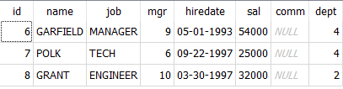
OFFSET Statement
Syntax: SELECT * FROM table_Name LIMIT 3 OFFSET 5;
SELECT * FROM employees LIMIT 3 OFFSET 5;
Notes:
Duration: 10 minutes
Highlights:
Introduce the definition.
Identify the unique attributes.
Provide examples to elaborate the concept and non-examples to show the difference.
Use whiteboard if required.
Key Takeaways:
In what ways, learners can use the concept in real-life situations to provide solutions or solve problems.

Slide 15

COUNT() Function
SELECT COUNT(*) FROM employees;
The COUNT() function in SQL is used to count the number of rows that match a specific condition.
Syntax : SELECT COUNT(column_name) FROM table_name;
Notes:
Duration: 10 minutes
Highlights:
Introduce the definition.
Identify the unique attributes.
Provide examples to elaborate the concept and non-examples to show the difference.
Use whiteboard if required.
Key Takeaways:
In what ways, learners can use the concept in real-life situations to provide solutions or solve problems.

Slide 16

COUNT() Function
SELECT COUNT(name) AS NameCount FROM employees;
To count number of names in present in “employee”
Syntax: SELECT COUNT(column_name) AS col_count FROM table_name;
Notes:
Duration: 10 minutes
Highlights:
Introduce the definition.
Identify the unique attributes.
Provide examples to elaborate the concept and non-examples to show the difference.
Use whiteboard if required.
Key Takeaways:
In what ways, learners can use the concept in real-life situations to provide solutions or solve problems.

Slide 17

COUNT() Function
SELECT COUNT(name) AS NameCount, COUNT(mgr) AS MgrCount FROM employees;
To count of two given columns, you can use following syntax:
Syntax: SELECT COUNT(col1) AS col1_count, COUNT(col2)AS col2_count FROM table_name;
Notes:
Duration: 10 minutes
Highlights:
Introduce the definition.
Identify the unique attributes.
Provide examples to elaborate the concept and non-examples to show the difference.
Use whiteboard if required.
Key Takeaways:
In what ways, learners can use the concept in real-life situations to provide solutions or solve problems.

Slide 18

DISTINCT Statement
SELECT DISTINCT job FROM employees;
The DISTINCT keyword in SQL is used to select and retrieve unique values from a specific column in a given table.
Syntax: SELECT DISTINCT col1 FROM table_name;
Notes:
Duration: 10 minutes
Highlights:
Introduce the definition.
Identify the unique attributes.
Provide examples to elaborate the concept and non-examples to show the difference.
Use whiteboard if required.
Key Takeaways:
In what ways, learners can use the concept in real-life situations to provide solutions or solve problems.

Slide 19

Unique Values in a Column
SELECT COUNT(DISTINCT job) AS UniqueJobs FROM employees;
To count the number of unique values in a column, you combine COUNT with DISTINCT.
Syntax: SELECT COUNT(DISTINCT col1)AS unique_values FROM table_name;
Notes:
Duration: 10 minutes
Highlights:
Introduce the definition.
Identify the unique attributes.
Provide examples to elaborate the concept and non-examples to show the difference.
Use whiteboard if required.
Key Takeaways:
In what ways, learners can use the concept in real-life situations to provide solutions or solve problems.

Slide 20
Filtering Numeric Data
The WHERE clause acts like a filter for your data. It picks out only the information that fits certain rules you've decided, helping you find and work with the exact data you're looking for in a table.
Syntax:
SELECT col, col2, FROM table_name WHERE condition;
OR
SELECT * FROM table_name WHERE condition;
Notes:
Duration: 10 minutes
Highlights:
Introduce the definition.
Identify the unique attributes.
Provide examples to elaborate the concept and non-examples to show the difference.
Use whiteboard if required.
Key Takeaways:
In what ways, learners can use the concept in real-life situations to provide solutions or solve problems.

Slide 21
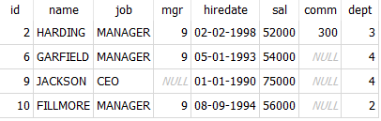
Filtering Numeric Data
SELECT * FROM employees WHERE sal > 35000;
Notes:
Duration: 10 minutes
Highlights:
Introduce the definition.
Identify the unique attributes.
Provide examples to elaborate the concept and non-examples to show the difference.
Use whiteboard if required.
Key Takeaways:
In what ways, learners can use the concept in real-life situations to provide solutions or solve problems.

Slide 22
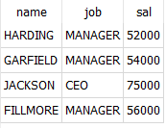
Filtering Numeric Data
SELECT name, job, sal FROM employees WHERE sal > 35000;
Notes:
Duration: 10 minutes
Highlights:
Introduce the definition.
Identify the unique attributes.
Provide examples to elaborate the concept and non-examples to show the difference.
Use whiteboard if required.
Key Takeaways:
In what ways, learners can use the concept in real-life situations to provide solutions or solve problems.

Slide 23
Filtering with Multiple Conditions
You can use multiple conditions in the WHERE clause by employing keywords like OR, AND, and BETWEEN to specify different criteria for retrieving data.
Notes:
Duration: 10 minutes
Highlights:
Introduce the definition.
Identify the unique attributes.
Provide examples to elaborate the concept and non-examples to show the difference.
Use whiteboard if required.
Key Takeaways:
In what ways, learners can use the concept in real-life situations to provide solutions or solve problems.

Slide 24
OR Operator
The "OR" operator is a way to filter data using multiple conditions. It helps select records that match at least one of the given conditions.
Syntax: SELECT col1, col2 FROM table_name WHERE condition1 OR condition2;
Notes:
Duration: 10 minutes
Highlights:
Introduce the definition.
Identify the unique attributes.
Provide examples to elaborate the concept and non-examples to show the difference.
Use whiteboard if required.
Key Takeaways:
In what ways, learners can use the concept in real-life situations to provide solutions or solve problems.

Slide 25
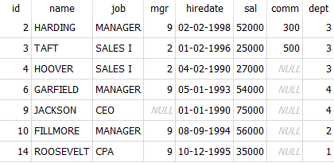
OR Operator
SELECT * FROM employees WHERE sal > 34000 or dept = 3;
Notes:
Duration: 10 minutes
Highlights:
Introduce the definition.
Identify the unique attributes.
Provide examples to elaborate the concept and non-examples to show the difference.
Use whiteboard if required.
Key Takeaways:
In what ways, learners can use the concept in real-life situations to provide solutions or solve problems.

Slide 26
AND Operator
The AND operator filters data based on multiple conditions, where all conditions need to be true for the record to be selected. It combines criteria to ensure records meet all specified conditions.
Syntax: SELECT col1, col2 FROM table_name WHERE condition1 AND condition2 AND ...;
Notes:
Duration: 10 minutes
Highlights:
Introduce the definition.
Identify the unique attributes.
Provide examples to elaborate the concept and non-examples to show the difference.
Use whiteboard if required.
Key Takeaways:
In what ways, learners can use the concept in real-life situations to provide solutions or solve problems.

Slide 27

AND Operator
SELECT * FROM employees WHERE sal > 34000 or dept = 4;
Notes:
Duration: 10 minutes
Highlights:
Introduce the definition.
Identify the unique attributes.
Provide examples to elaborate the concept and non-examples to show the difference.
Use whiteboard if required.
Key Takeaways:
In what ways, learners can use the concept in real-life situations to provide solutions or solve problems.

Slide 28
BETWEEN Operator
The BETWEEN keyword filters values within a specific range, including the starting and ending values. It's a shortcut to easily select data falling within a defined range.
Syntax: SELECT column_name(s) FROM table_name WHERE column_name BETWEEN value1 AND value2;
Notes:
Duration: 10 minutes
Highlights:
Introduce the definition.
Identify the unique attributes.
Provide examples to elaborate the concept and non-examples to show the difference.
Use whiteboard if required.
Key Takeaways:
In what ways, learners can use the concept in real-life situations to provide solutions or solve problems.

Slide 29
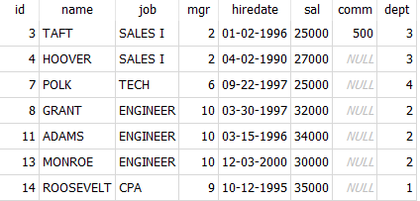
BETWEEN Operator
SELECT * FROM employees WHERE sal BETWEEN 25000 AND 40000;
Notes:
Duration: 10 minutes
Highlights:
Introduce the definition.
Identify the unique attributes.
Provide examples to elaborate the concept and non-examples to show the difference.
Use whiteboard if required.
Key Takeaways:
In what ways, learners can use the concept in real-life situations to provide solutions or solve problems.

Slide 30
Filtering Text Data & Nulls
In SQL, we can filter text data using the WHERE clause. So far, we've been filtering exact text matches. Now, let's explore three new keywords: LIKE, NOT LIKE, and IN.
Notes:
Duration: 10 minutes
Highlights:
Introduce the definition.
Identify the unique attributes.
Provide examples to elaborate the concept and non-examples to show the difference.
Use whiteboard if required.
Key Takeaways:
In what ways, learners can use the concept in real-life situations to provide solutions or solve problems.

Slide 31
LIKE Operator
In SQL, we use the LIKE operator with the WHERE clause to find patterns within fields using placeholders called wildcards.
There are two wildcards: the percent (%) matches zero, one, or multiple characters, while the underscore (_) matches a single character.
SELECT * FROM table_name
WHERE column_name LIKE 'A%';
SELECT * FROM table_name
WHERE column_name
LIKE 'Ad_l';
Notes:
Duration: 10 minutes
Highlights:
Introduce the definition.
Identify the unique attributes.
Provide examples to elaborate the concept and non-examples to show the difference.
Use whiteboard if required.
Key Takeaways:
In what ways, learners can use the concept in real-life situations to provide solutions or solve problems.

Slide 32

LIKE Operator
SELECT * FROM employees WHERE name LIKE 'H%';
Notes:
Duration: 10 minutes
Highlights:
Introduce the definition.
Identify the unique attributes.
Provide examples to elaborate the concept and non-examples to show the difference.
Use whiteboard if required.
Key Takeaways:
In what ways, learners can use the concept in real-life situations to provide solutions or solve problems.

Slide 33

LIKE Operator
SELECT * FROM employees WHERE name LIKE 'HOOV_R';
Notes:
Duration: 10 minutes
Highlights:
Introduce the definition.
Identify the unique attributes.
Provide examples to elaborate the concept and non-examples to show the difference.
Use whiteboard if required.
Key Takeaways:
In what ways, learners can use the concept in real-life situations to provide solutions or solve problems.

Slide 34
IN Operator
The IN operator in SQL helps to set multiple conditions using a single WHERE clause by specifying various values. It's a handy way to handle multiple options at once. Cool, right?
Syntax: SELECT column_name(s) FROM table_name WHERE column_name IN (value1, value2, ...);
Notes:
Duration: 10 minutes
Highlights:
Introduce the definition.
Identify the unique attributes.
Provide examples to elaborate the concept and non-examples to show the difference.
Use whiteboard if required.
Key Takeaways:
In what ways, learners can use the concept in real-life situations to provide solutions or solve problems.

Slide 35
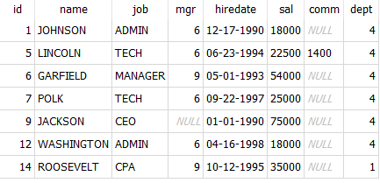
IN Operator
SELECT * FROM employees WHERE dept IN (1,4);
Notes:
Duration: 10 minutes
Highlights:
Introduce the definition.
Identify the unique attributes.
Provide examples to elaborate the concept and non-examples to show the difference.
Use whiteboard if required.
Key Takeaways:
In what ways, learners can use the concept in real-life situations to provide solutions or solve problems.

Slide 36
Handling NULL Values
In databases, NULL represents missing or unknown information. It's a keyword used in SQL to signify that the data for a particular field is not available or unknown.
We can use the IS NULL and IS NOT NULL operators with the WHERE clause to work with NULL values.
SELECT * FROM table_name
WHERE column_name IS NULL;
SELECT * FROM table_name
WHERE column_name IS NULL;
Notes:
Duration: 10 minutes
Highlights:
Introduce the definition.
Identify the unique attributes.
Provide examples to elaborate the concept and non-examples to show the difference.
Use whiteboard if required.
Key Takeaways:
In what ways, learners can use the concept in real-life situations to provide solutions or solve problems.

Slide 37
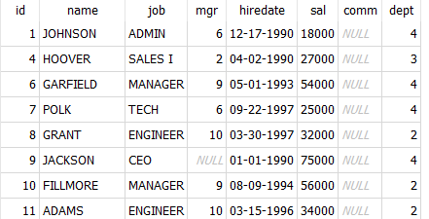
Handling NULL Values
SELECT * FROM employees WHERE comm IS NULL;
Notes:
Duration: 10 minutes
Highlights:
Introduce the definition.
Identify the unique attributes.
Provide examples to elaborate the concept and non-examples to show the difference.
Use whiteboard if required.
Key Takeaways:
In what ways, learners can use the concept in real-life situations to provide solutions or solve problems.

Slide 38

Handling NULL Values
SELECT * FROM employees WHERE comm IS NOT NULL;
Notes:
Duration: 10 minutes
Highlights:
Introduce the definition.
Identify the unique attributes.
Provide examples to elaborate the concept and non-examples to show the difference.
Use whiteboard if required.
Key Takeaways:
In what ways, learners can use the concept in real-life situations to provide solutions or solve problems.

Slide 39

Count Missing Values
SELECT COUNT(*) AS missingValues FROM employees WHERE comm IS NULL;
Notes:
Duration: 10 minutes
Highlights:
Introduce the definition.
Identify the unique attributes.
Provide examples to elaborate the concept and non-examples to show the difference.
Use whiteboard if required.
Key Takeaways:
In what ways, learners can use the concept in real-life situations to provide solutions or solve problems.

Slide 40

Count Missing Values
SELECT count(*) AS notmissingValues FROM employees WHERE comm IS NOT NULL;
Notes:
Duration: 10 minutes
Highlights:
Introduce the definition.
Identify the unique attributes.
Provide examples to elaborate the concept and non-examples to show the difference.
Use whiteboard if required.
Key Takeaways:
In what ways, learners can use the concept in real-life situations to provide solutions or solve problems.

Slide 41
Sorting Data with ORDER BY
In SQL, sorting is like organizing data for easier use. The ORDER BY clause helps arrange data by one or more fields. Just place it after the FROM statement in your SQL query to sort the results.
Syntax:
SELECT * FROM table_name ORDER BY column;
OR
SELECT * FROM table_name ORDER BY column1 [ASC|DESC];
Notes:
Duration: 10 minutes
Highlights:
Introduce the definition.
Identify the unique attributes.
Provide examples to elaborate the concept and non-examples to show the difference.
Use whiteboard if required.
Key Takeaways:
In what ways, learners can use the concept in real-life situations to provide solutions or solve problems.

Slide 42
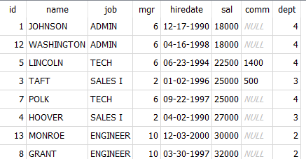
Sorting Data with ORDER BY
SELECT * FROM employees ORDER BY sal;
Notes:
Duration: 10 minutes
Highlights:
Introduce the definition.
Identify the unique attributes.
Provide examples to elaborate the concept and non-examples to show the difference.
Use whiteboard if required.
Key Takeaways:
In what ways, learners can use the concept in real-life situations to provide solutions or solve problems.

Slide 43
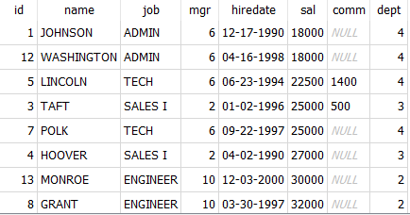
Sorting Data with ORDER BY
SELECT * FROM employees ORDER BY sal ASC;
Notes:
Duration: 10 minutes
Highlights:
Introduce the definition.
Identify the unique attributes.
Provide examples to elaborate the concept and non-examples to show the difference.
Use whiteboard if required.
Key Takeaways:
In what ways, learners can use the concept in real-life situations to provide solutions or solve problems.

Slide 44
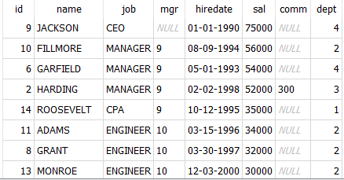
Sorting Data with ORDER BY
SELECT * FROM employees ORDER BY sal DESC;
Notes:
Duration: 10 minutes
Highlights:
Introduce the definition.
Identify the unique attributes.
Provide examples to elaborate the concept and non-examples to show the difference.
Use whiteboard if required.
Key Takeaways:
In what ways, learners can use the concept in real-life situations to provide solutions or solve problems.

Slide 45
Group By Clause
The GROUP BY clause in SQL is used to arrange identical data into groups. This is particularly useful when you want to perform aggregate functions (like COUNT, SUM, AVG, MAX, or MIN) on specific columns. When you use GROUP BY, the result set is returned as a summary table with one row for each group.
Syntax: SELECT col1, agg_fun(col2) FROM table_name WHERE condition GROUP BY col1;
SELECT dept, SUM(sal) as total_salary
FROM employees GROUP BY dept;
Notes:
Duration: 10 minutes
Highlights:
Introduce the definition.
Identify the unique attributes.
Provide examples to elaborate the concept and non-examples to show the difference.
Use whiteboard if required.
Key Takeaways:
In what ways, learners can use the concept in real-life situations to provide solutions or solve problems.

Slide 46
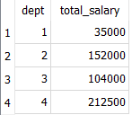
Group By Clause
SELECT dept, SUM(sal) as total_salary FROM employees GROUP BY dept;
Notes:
Duration: 10 minutes
Highlights:
Introduce the definition.
Identify the unique attributes.
Provide examples to elaborate the concept and non-examples to show the difference.
Use whiteboard if required.
Key Takeaways:
In what ways, learners can use the concept in real-life situations to provide solutions or solve problems.

Slide 47
Having Clause
The HAVING clause is used in SQL along with the GROUP BY clause to filter the results of a query based on aggregate conditions.
It allows you to specify a condition for groups of rows, similar to the WHERE clause for individual rows. The HAVING clause is particularly useful when you want to filter the results of aggregate functions.
Syntax: SELECT column1, agg fun(column2) FROM table_name WHERE condition GROUP BY column1 HAVING aggregate_condition;
Notes:
Duration: 10 minutes
Highlights:
Introduce the definition.
Identify the unique attributes.
Provide examples to elaborate the concept and non-examples to show the difference.
Use whiteboard if required.
Key Takeaways:
In what ways, learners can use the concept in real-life situations to provide solutions or solve problems.

Slide 48
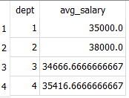
Having Clause
SELECT dept, AVG(sal) as total_salary FROM employees GROUP BY dept HAVING AVG(sal) > 25000;
Notes:
Duration: 10 minutes
Highlights:
Introduce the definition.
Identify the unique attributes.
Provide examples to elaborate the concept and non-examples to show the difference.
Use whiteboard if required.
Key Takeaways:
In what ways, learners can use the concept in real-life situations to provide solutions or solve problems.

Slide 49
Difference Between WHERE and GROUP BY
Aspect | WHERE Clause | GROUP BY Clause
Function | Filters individual rows based on specified conditions. | Groups rows based on values in one or more columns.
Syntax | SELECT column1, column2,... FROM table WHERE condition; | SELECT column1, aggregate_function(column2) FROM table WHERE condition GROUP BY column1, column2, ...;
Use with Aggregates | Typically used with conditions involving individual row values. | Used in conjunction with aggregate functions for group-level calculations
Example Query | SELECT * FROM employees WHERE salary > 50000; | SELECT department, AVG(salary) FROM employees GROUP BY department;
Notes:
Duration: 10 minutes
Highlights:
Introduce the definition.
Identify the unique attributes.
Provide examples to elaborate the concept and non-examples to show the difference.
Use whiteboard if required.
Key Takeaways:
In what ways, learners can use the concept in real-life situations to provide solutions or solve problems.

Slide 50
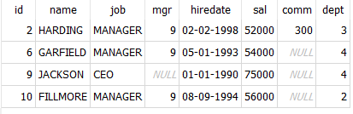
Difference Between WHERE and GROUP BY
SELECT * FROM employees WHERE sal > 50000;
Notes:
Duration: 10 minutes
Highlights:
Introduce the definition.
Identify the unique attributes.
Provide examples to elaborate the concept and non-examples to show the difference.
Use whiteboard if required.
Key Takeaways:
In what ways, learners can use the concept in real-life situations to provide solutions or solve problems.

Slide 51
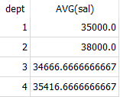
Difference Between WHERE and GROUP BY
SELECT dept, AVG(sal) FROM employees GROUP BY dept;
Notes:
Duration: 10 minutes
Highlights:
Introduce the definition.
Identify the unique attributes.
Provide examples to elaborate the concept and non-examples to show the difference.
Use whiteboard if required.
Key Takeaways:
In what ways, learners can use the concept in real-life situations to provide solutions or solve problems.

Slide 52

Summary
In the data science journey, mastering SQL's core essentials is pivotal. Our session focused on precision through SELECT for targeted data extraction and WHERE for refined data segmentation.
We explored dataset insights with COUNT(), ensuring efficient exploration via LIMIT and OFFSET. Logical data arrangement with ORDER BY and uncovering unique insights using DISTINCT were highlighted.
Additionally, GROUP BY with aggregate functions and HAVING for refined insights enriched our understanding.
Distinguishing between HAVING and WHERE provided clarity in filtering methods, empowering data-driven decision-making in diverse data science applications.
Notes:
Duration: 10 minutes
Highlights:
Introduce the definition.
Identify the unique attributes.
Provide examples to elaborate the concept and non-examples to show the difference.
Use whiteboard if required.
Key Takeaways:
In what ways, learners can use the concept in real-life situations to provide solutions or solve problems.

